Slide 1
MAUI Community Toolkit을 활용한
효과적인 MAUI 앱 개발

Slide 2



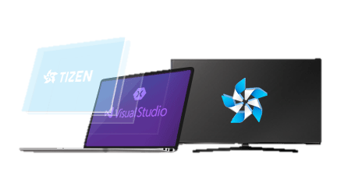

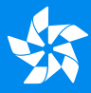
조중현
Samsung Research
jh5.cho@Samsung.com
2017
Tizen 4.0
.NET / IoT
2018
Tizen 5.0
On-device AI
2020
Tizen 6.0
Intelligent Service
2022
Tizen 7.0
.NET6 / MAUI

Slide 3
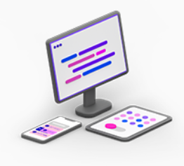


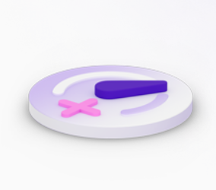
.NET MAUI
Multi-platform
One Codebase
Productive
- .NET Multi-platform App UI
One Codebase
Single C# codebase
Single project system
Multi-platform
Android, iOS, macOS, Windows, and Tizen
Productive
Integrating the power of Visual Studio
Notes:
.NET6 와 함께 소개된 Xamarin.Forms의 향상된 crossplatform UI Framework 입니다.
Single Project 기반으로 Android, iOS와 같은 mobile 앱 뿐만 아니라 Mac 과 Windows Desktop의 네이티브 앱도 빌드할 수 있습니다. 그리고 Tizen 또한 지원이 됩니다.
You can do this all from a shared single code base, and best part of this is that there’s great tooling in VS to make you super productive from the beginning
Build Cross-platform native applications for Desktop and Mobile

Slide 4
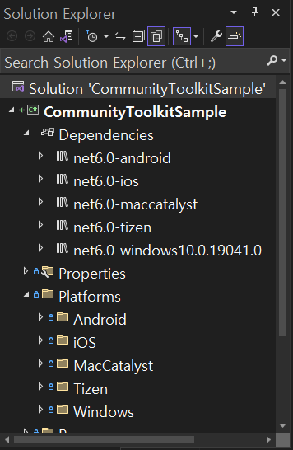
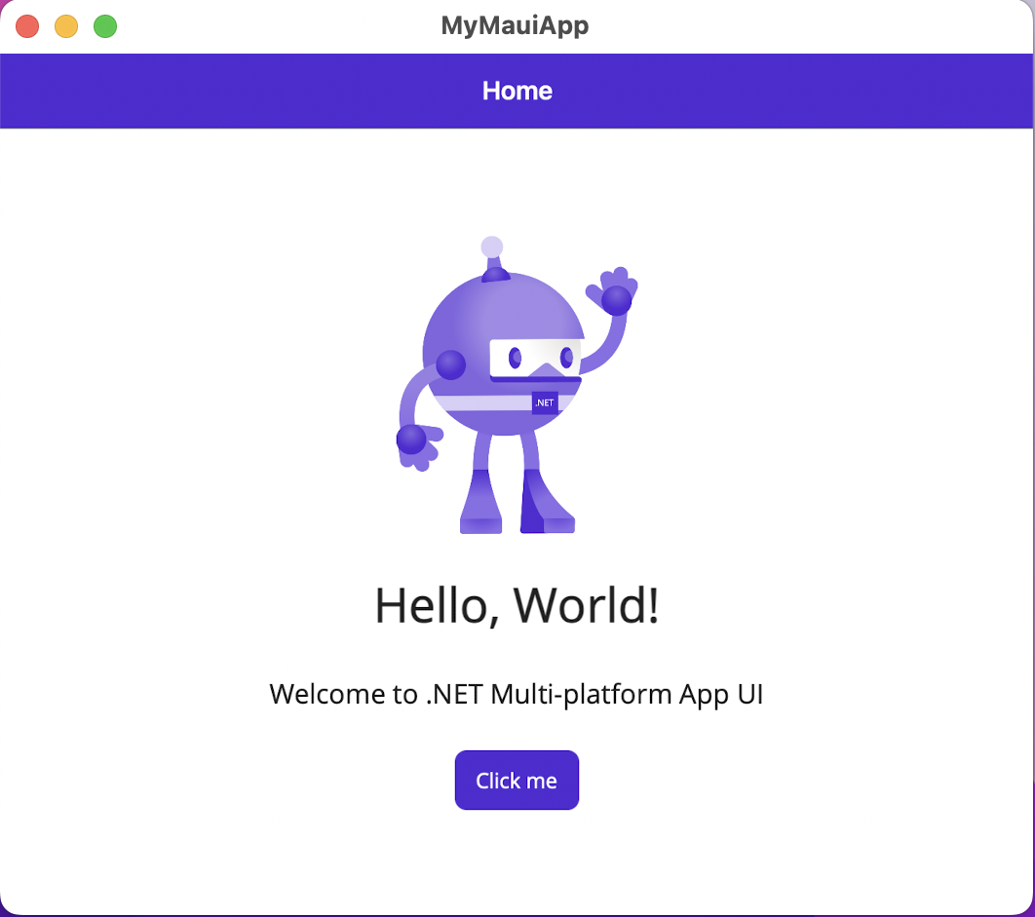
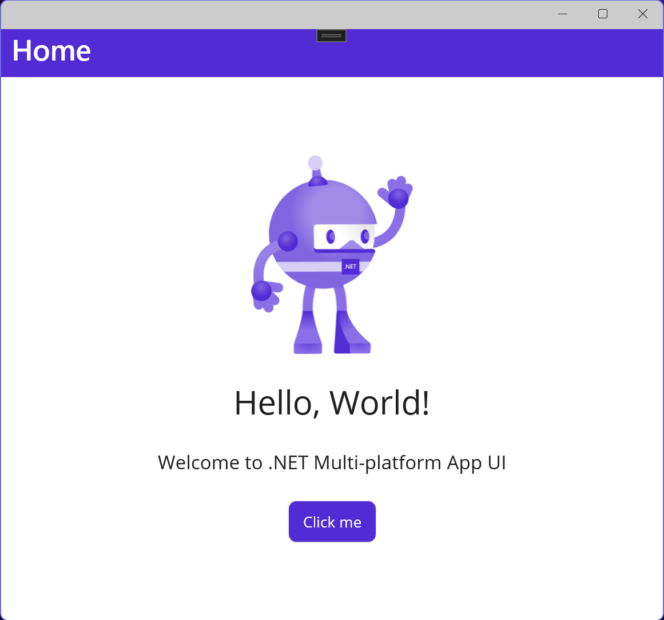
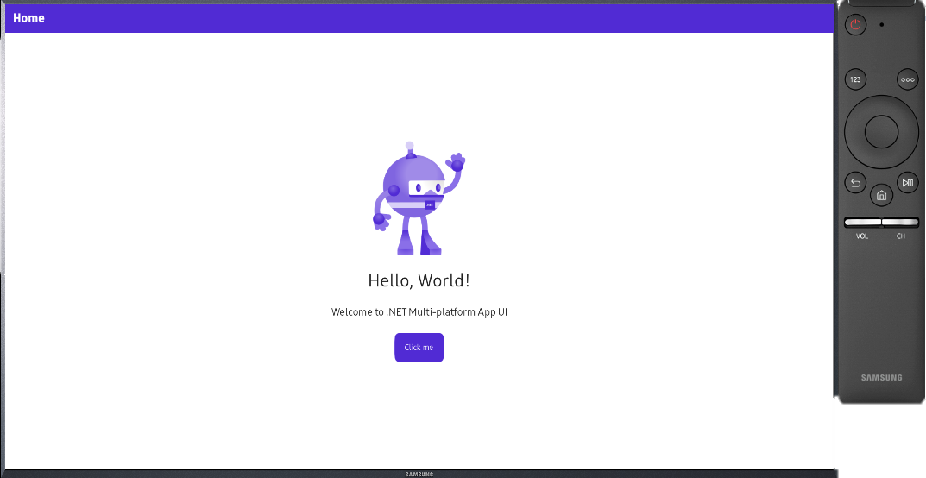
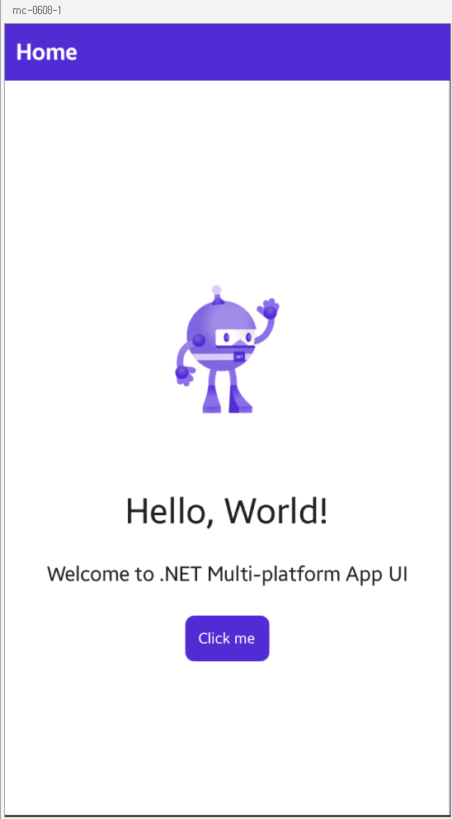
One codebase, single project, multi target
https://github.com/Samsung/Tizen.NET
- .NET Multi-platform App UI
One Codebase
Single C# codebase
Single project system
Multi-platform
Android, iOS, macOS, Windows, and Tizen
Productive
Integrating the power of Visual Studio

Slide 5
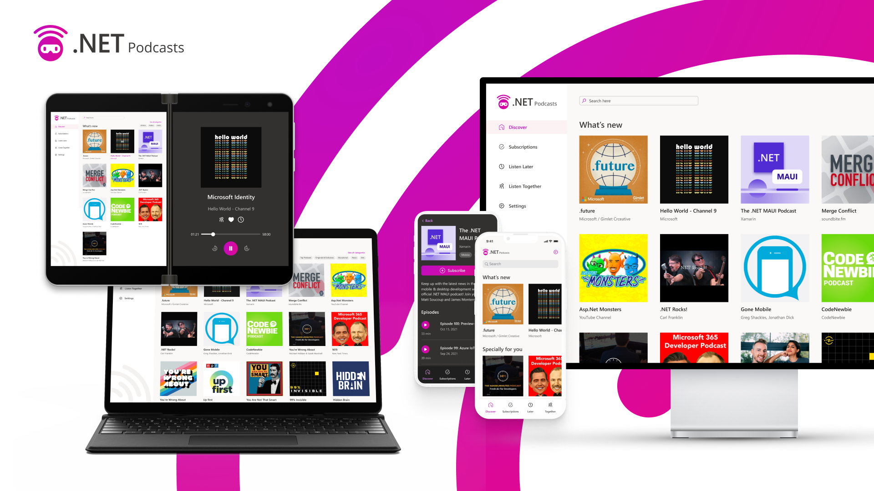
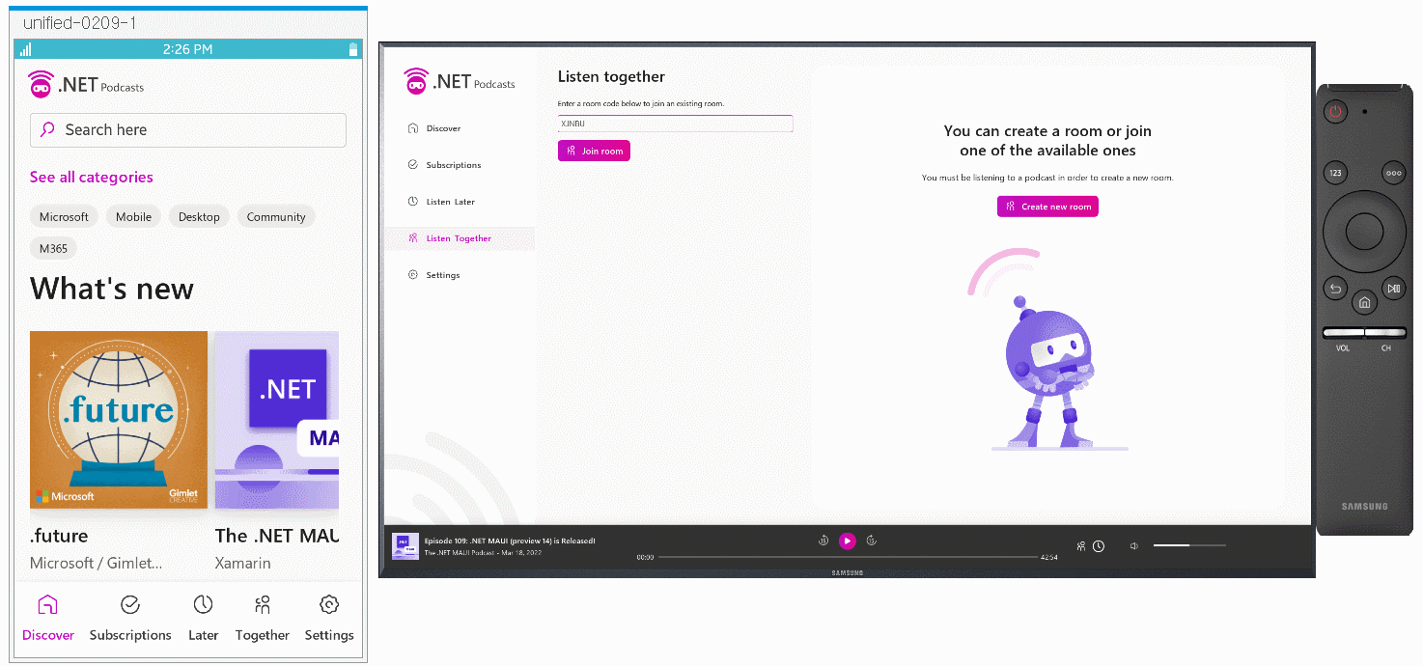

Slide 6

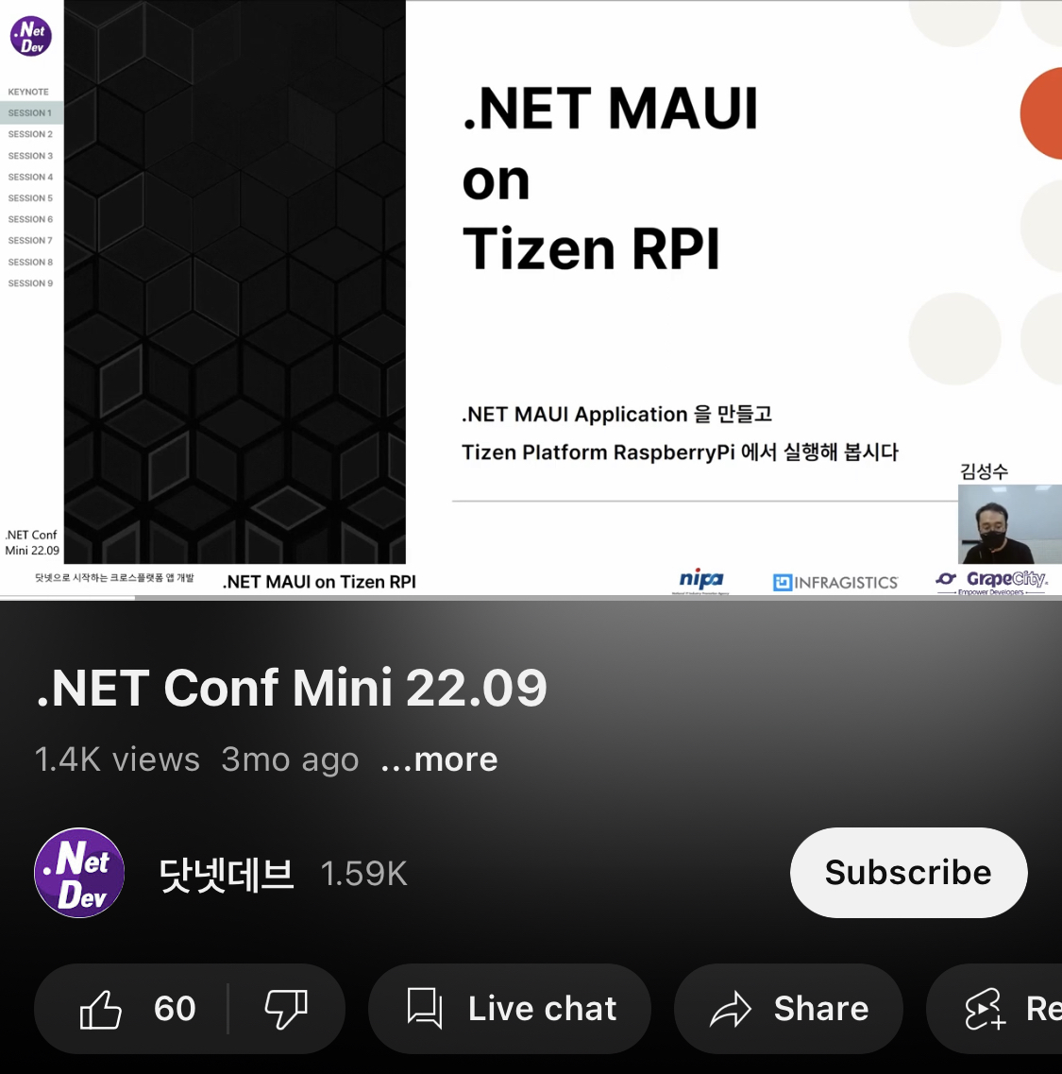
.NET MAUI
.NET Conf Mini 22.09
.NET MAUI on Tizen RPI
.NET MAUI 소개 (.NET Conf 2022 x Seoul Replay)
Notes:
셋다 nugget 이름

Slide 7
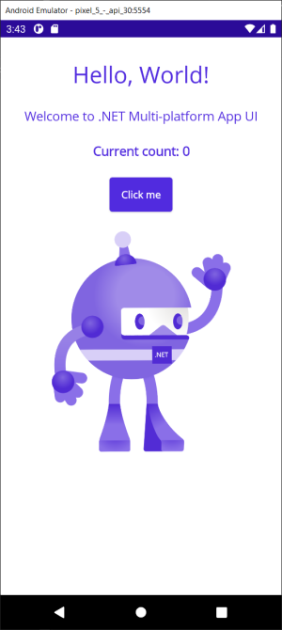
그 다음?

Slide 8
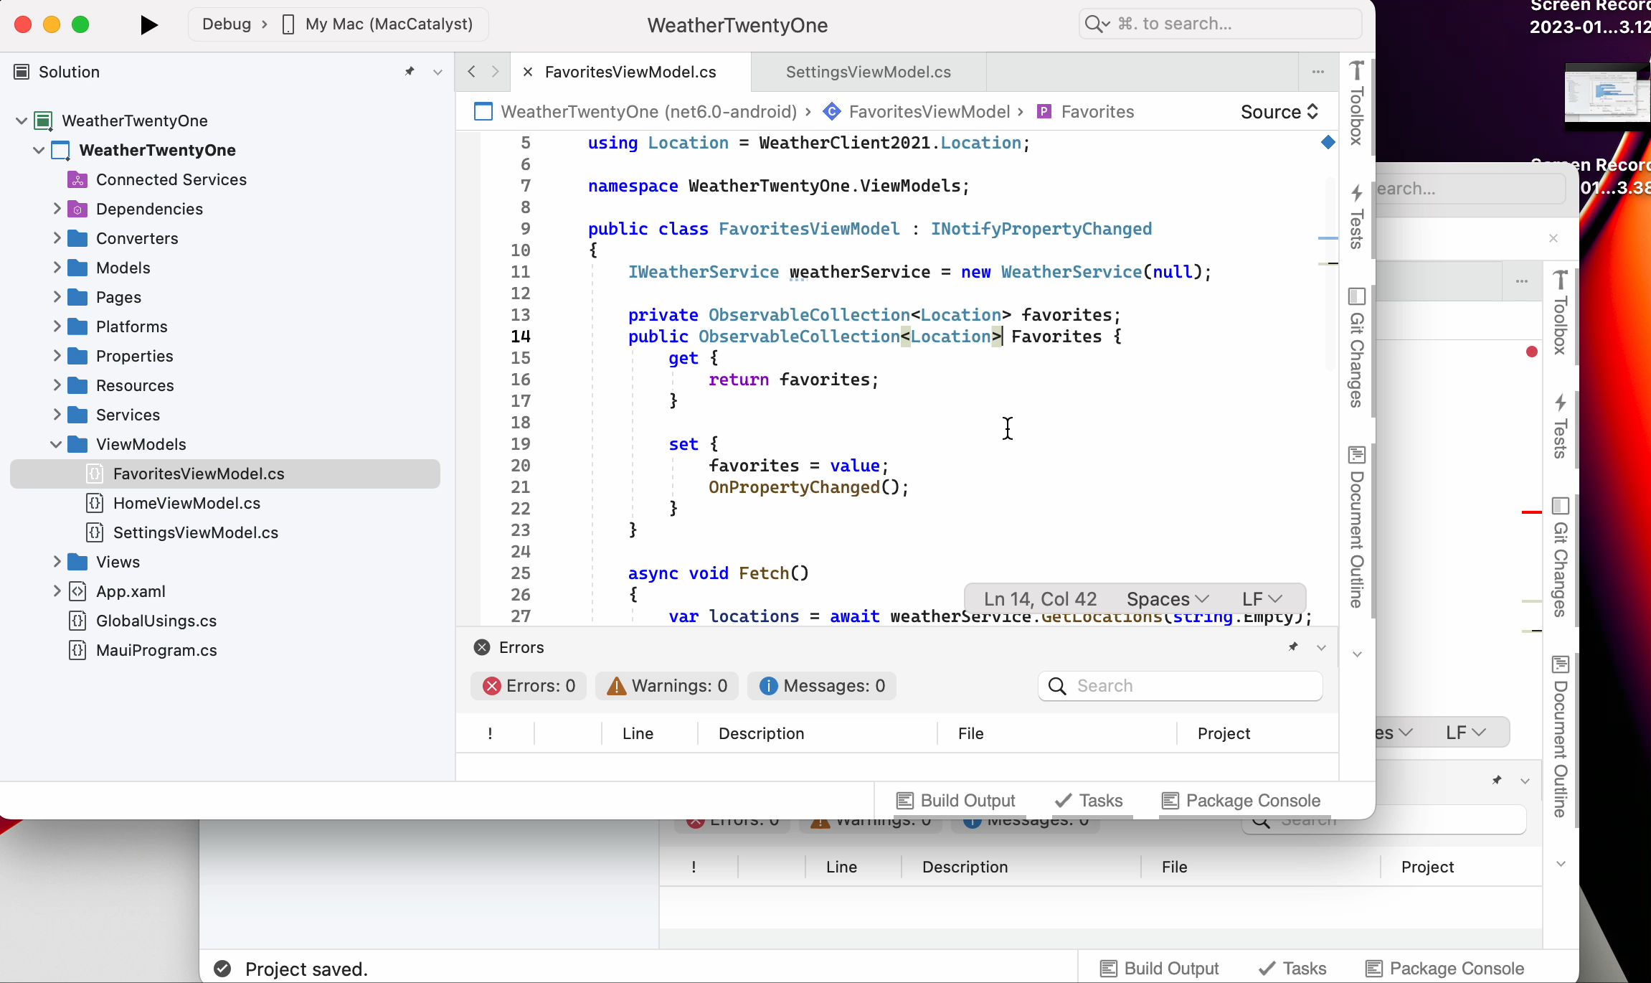

Slide 9

.NET Community Toolkits
Community Created libraries
3 Recommended Libraries
CommunityToolkit.Maui
CommunityToolkit.Mvvm
CommunityToolkit.Maui.Markup
Notes:
.NET Community Toolkit is a collection of helpers and APIs that work for all .NET developers and are agnostic of any specific UI platform. The toolkit is maintained and published by Microsoft, and part of the .NET Foundation.
Improve .NET MAUI Developer Experience
Help You Write Less Code

Slide 10
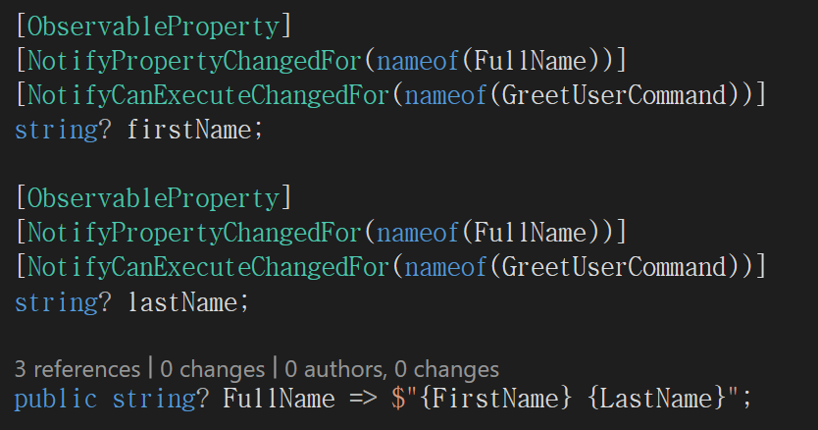
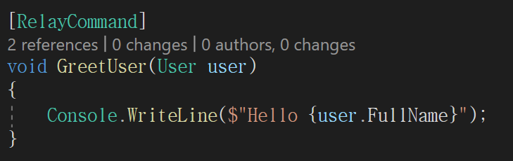
.NET Community Toolkits - CommunityToolkit.Mvvm
Use Attributes to Simplify Code
[RelayCommand]
[ObservableProperty]
[NotifyPropertyChangedFor]]
[NotifyCanExecuteChangedFor]
MVVM Toolkit을 사용하려는 개발자를 위한 안내
박문찬
Notes:
[AlsoNotifyChangeFor] ---> [NotifyPropertyChangedFor]
[AlsoNotifyCanExecuteFor] ---> [NotifyCanExecuteChangedFor]
[AlsoValidateProperty] ---> [NotifyDataErrorInfo]
[AlsoBroadcastChange] ---> [NotifyPropertyChangeRecipients]
[ICommand] ---> [RelayCommand]

Slide 11
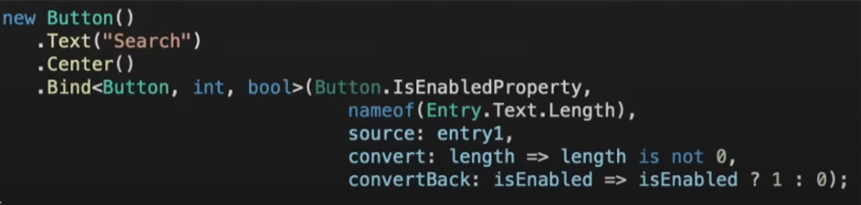
.NET Community Toolkits - CommunityToolkit.Maui.Markup
Fluent C# UI Extension Methods
Easier Layouts
Easier Converters
Easier Binding
Notes:
Easier Converter, Binding, Layouts , type safe

Slide 12
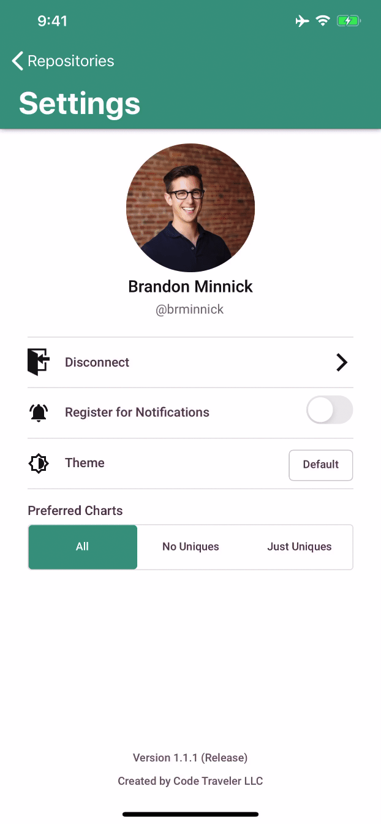
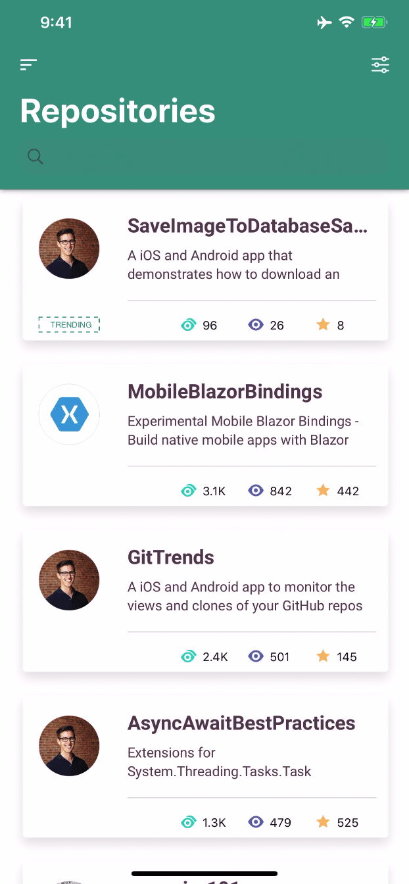
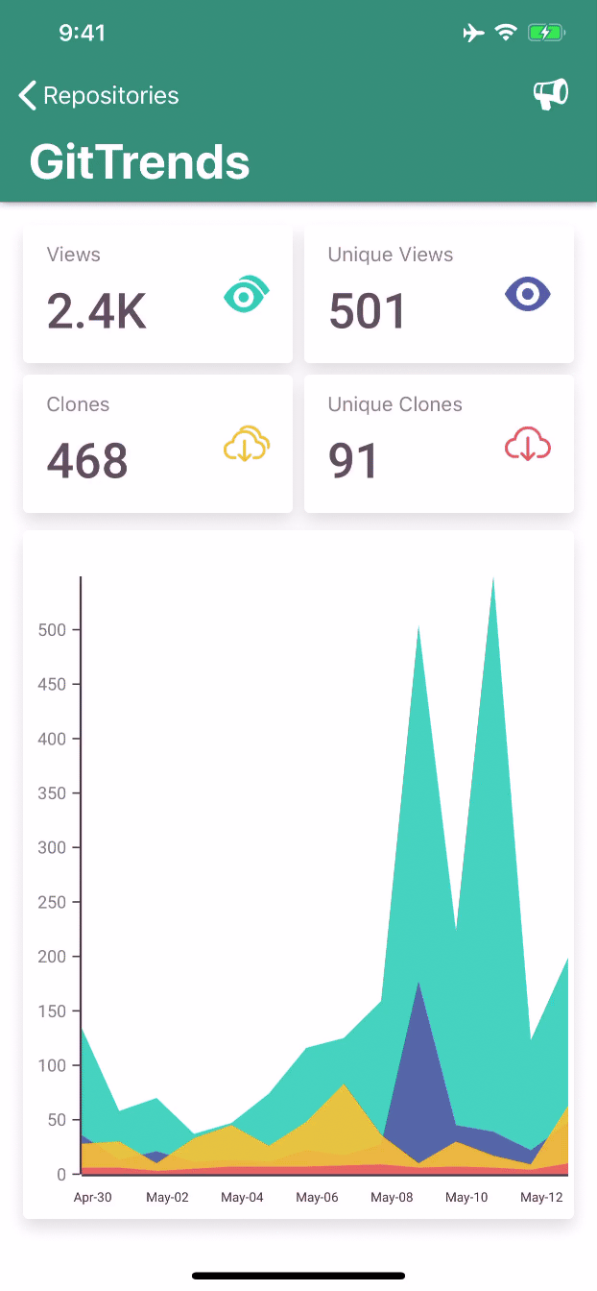
GitTrends: GitHub Insights
Author
👤 Brandon Minnick
Twitter: @TheCodeTraveler
Blog: https://codetraveler.io
Github: @brminnick
https://github.com/brminnick/GitTrends

Slide 13
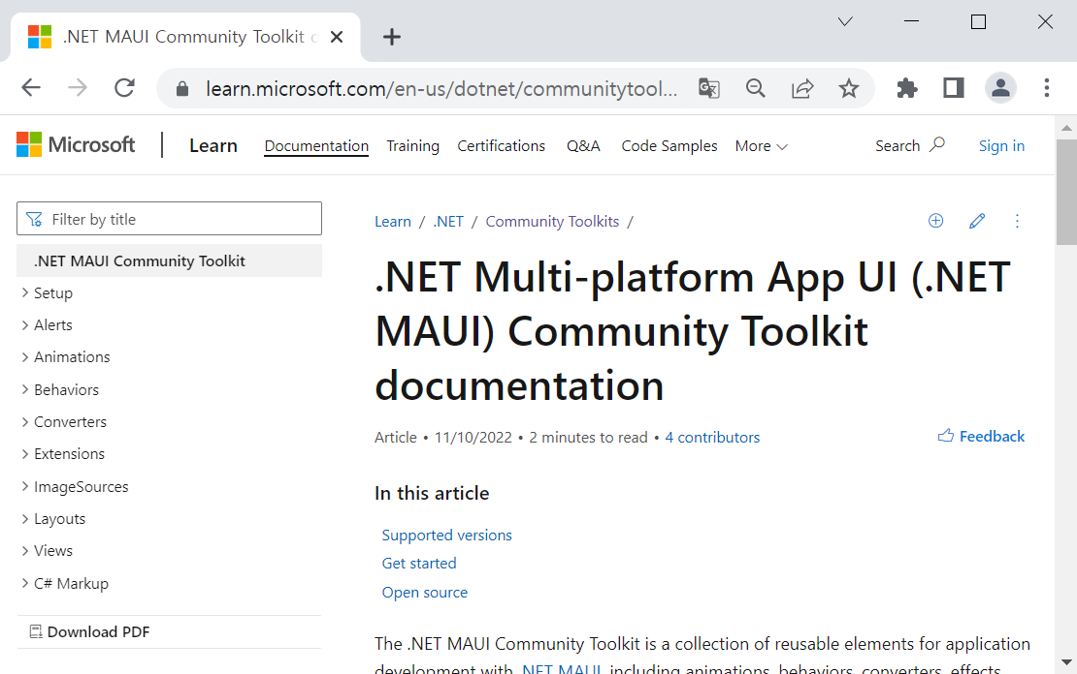

.NET Community Toolkits - CommunityToolkit.MAUI
Project maintained by the community
Provides common building blocks for developers
Animations, behaviors , converters, effects, and helpers
Incubator for new controls / features
Docs
Monthly standup live stream, etc.
Notes:
.NET Community Toolkit: https://learn.microsoft.com/en-us/dotnet/communitytoolkit/introduction
MCT: https://learn.microsoft.com/en-us/dotnet/communitytoolkit/maui/

Slide 14
.NET Community Toolkits - CommunityToolkit.Maui
Alerts
Animations
Behaviors
Converters
Extensions
ImageSources
Layouts
Views

Slide 15
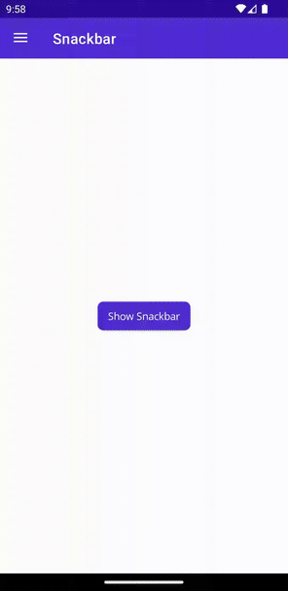
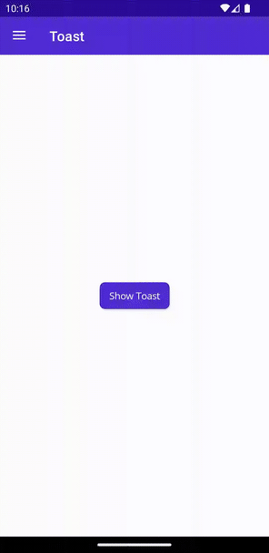
.NET Community Toolkits - CommunityToolkit.Maui
Alerts
Animations
Behaviors
Converters
Extensions
ImageSources
Layouts
Views
Snackbar
Toast

Slide 16
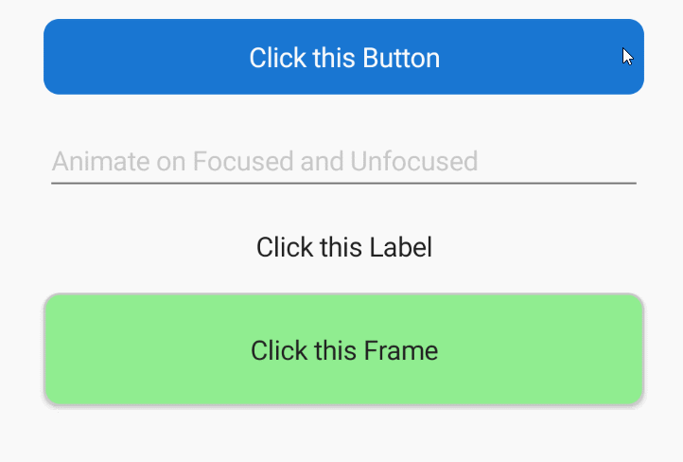
.NET Community Toolkits - CommunityToolkit.Maui
Alerts
Animations
Behaviors
Converters
Extensions
ImageSources
Layouts
Views

Slide 17
.NET Community Toolkits - CommunityToolkit.Maui
Alerts
Animations
Behaviors
Converters
Extensions
ImageSources
Layouts
Views
Animation
Characters Validation
Email Validation
Event-To-Command
Icon Tint Color
Masked
Max Length Reached
Multi Validation
Numeric Validation
Progress Bar Animation
Required String Validation
Set Focus On Entry Completed
Status Bar
Text Validation
Uri Validation
User Stopped Typing

Slide 18
.NET Community Toolkits - CommunityToolkit.Maui
Alerts
Animations
Behaviors
Converters
Extensions
ImageSources
Layouts
Views
Bool-To-Object
ByteArray-To-ImageSource
Color-To-Color
Compare Converter
Date-To-TimeOffset
Double-To-Int
Enum-To-Bool
Enum-To-Int
ImageResource Converter
Index-To-ArrayItem
Int-To-Bool
Inverted Bool
Is Equal
Is In Range
Is List Not Null Or Empty
Is Null
Is String Null Or EmptyList-To-String
MultiConverter
SelectedItemEventArgs
State-To-Bool
String-To-List
Text Case
Variable Multi Value
etc

Slide 19
.NET Community Toolkits - CommunityToolkit.Maui
Alerts
Animations
Behaviors
Converters
Extensions
ImageSources
Layouts
Views
ColorAnimation

Slide 20
.NET Community Toolkits - CommunityToolkit.Maui
Alerts
Animations
Behaviors
Converters
Extensions
ImageSources
Layouts
Views
GravatarImageSource

Slide 21
.NET Community Toolkits - CommunityToolkit.Maui
Alerts
Animations
Behaviors
Converters
Extensions
ImageSources
Layouts
Views
DocLayout
StateContainer
UniformItemsLayout

Slide 22
.NET Community Toolkits - CommunityToolkit.Maui
Alerts
Animations
Behaviors
Converters
Extensions
ImageSources
Layouts
Views
AvatarView
DrawingView
Expander
Popup

Slide 23
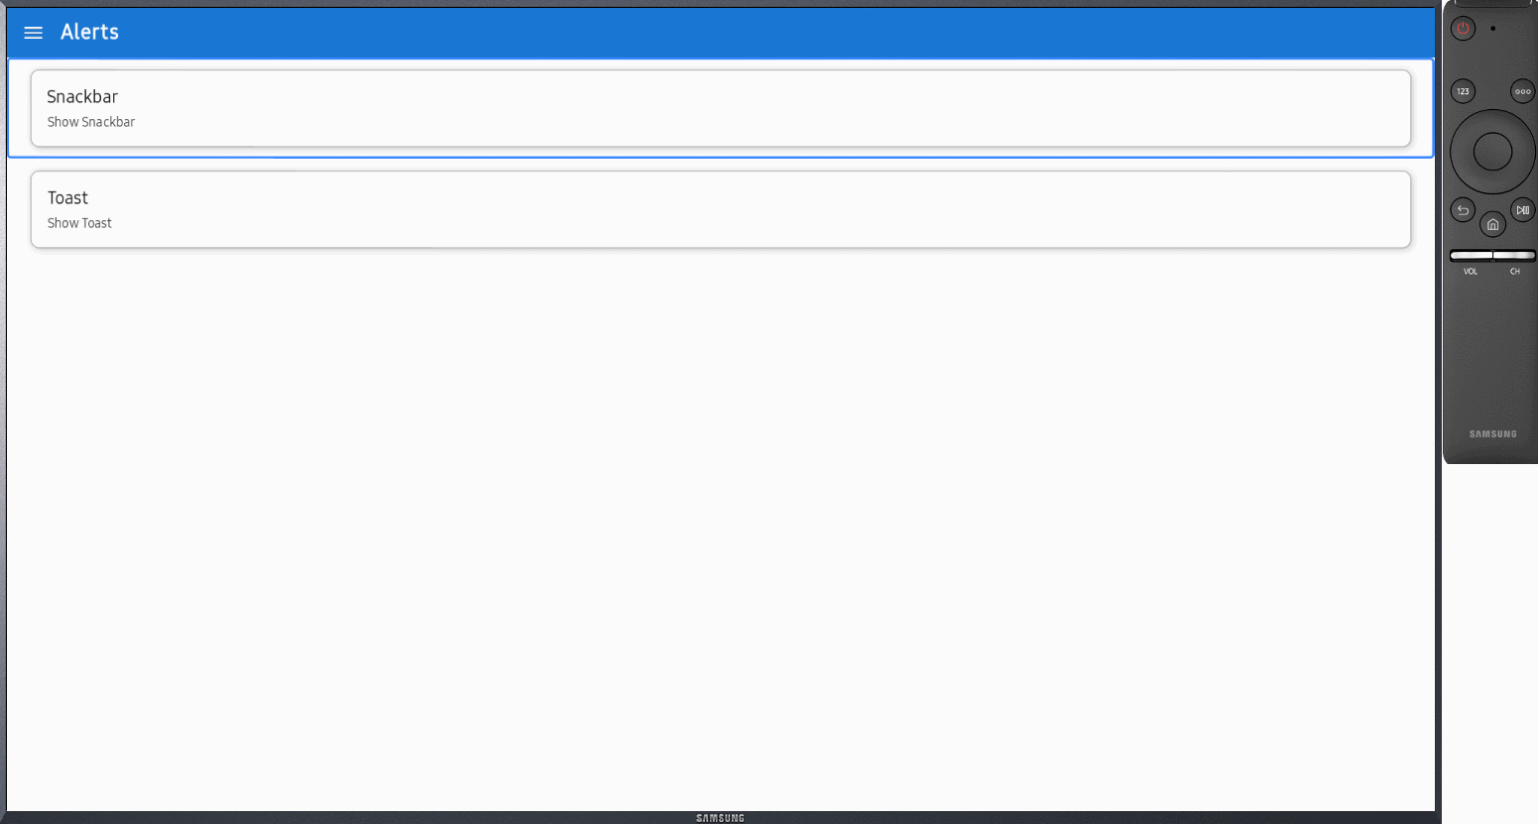
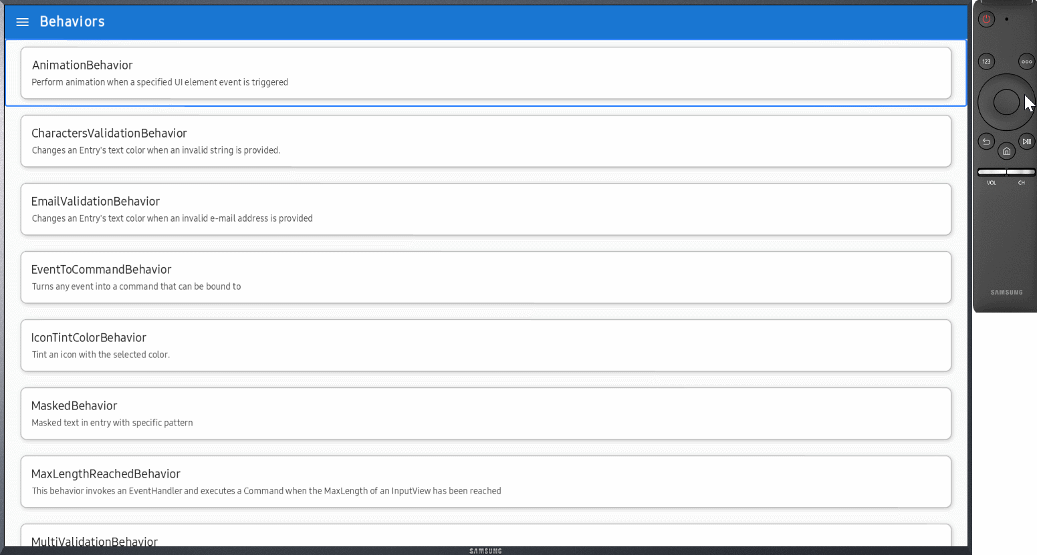
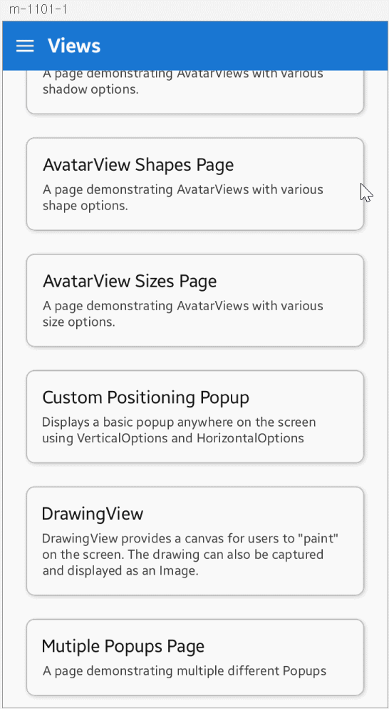

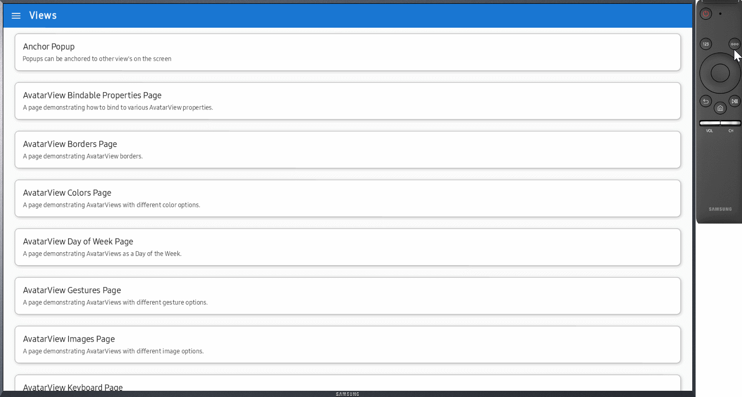
MAUI Community Toolkits on Tizen

Slide 24
.NET Community Toolkits
V1.4.0
Expander, DockLayout, and StateConatiner
V2.0.0
.NET6, Tizen
V3.0.0
Built against .NET7
V3.x.x
Dialogs
MediaPlayer

Slide 25
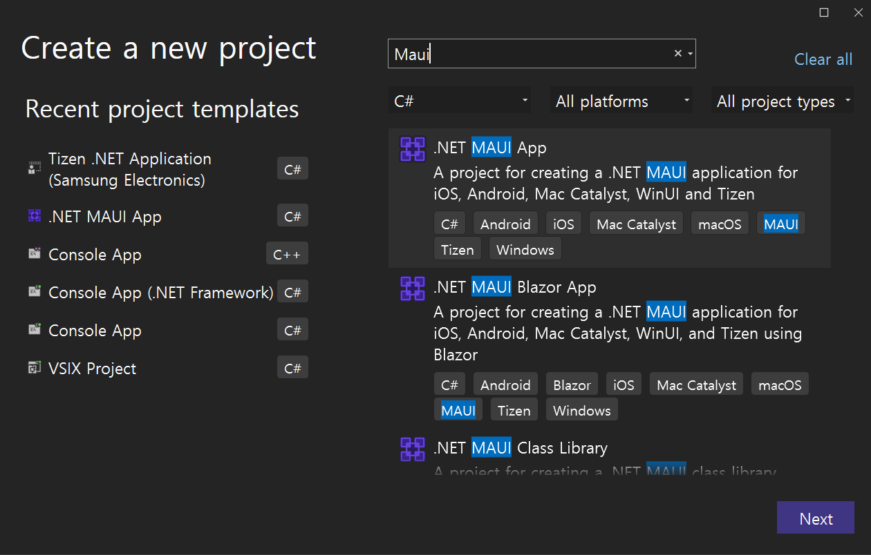
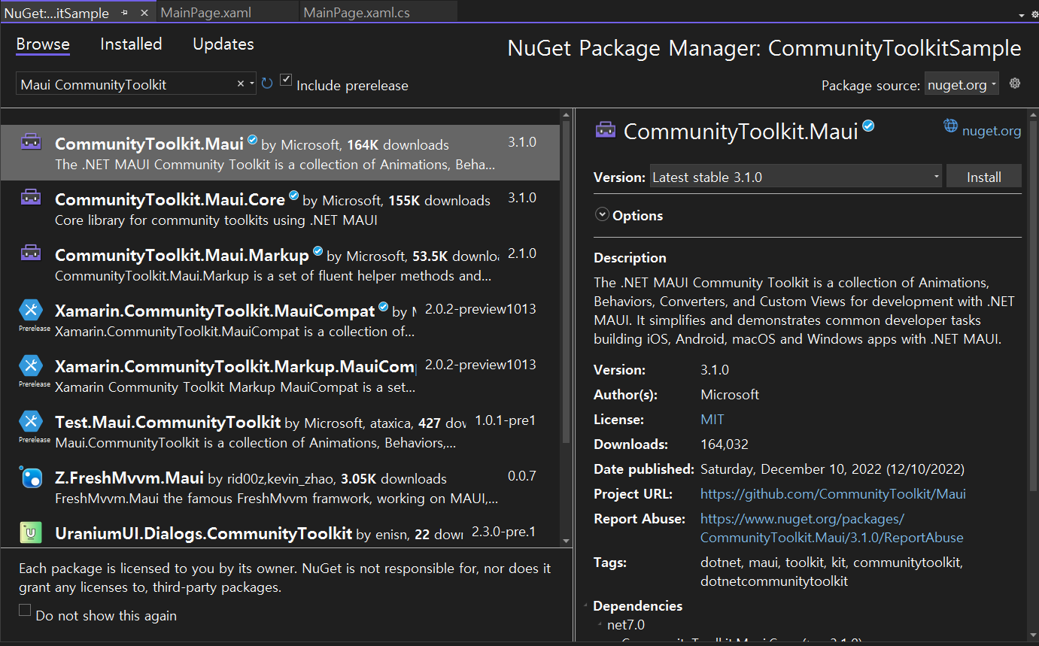
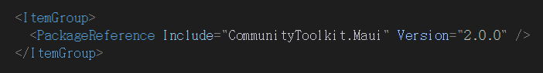
How to use Maui Community Toolkit
New MAUI App
Add package
~$ dotnet new maui –n “CommunityToolkitSample”

Slide 26
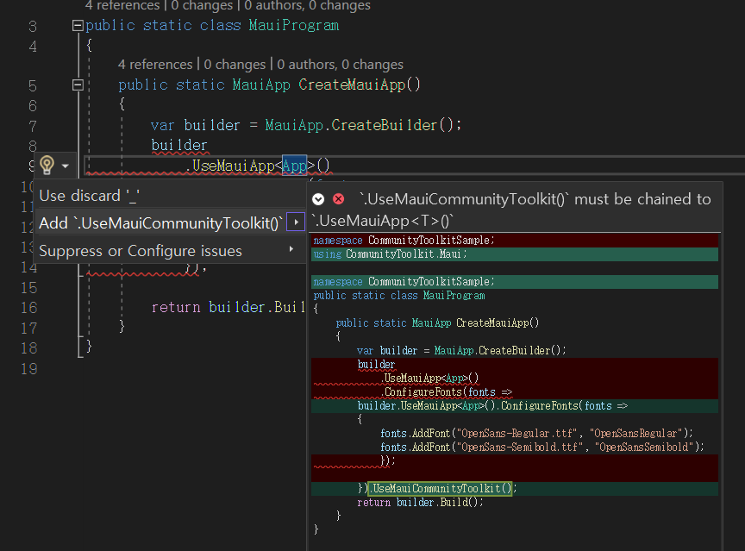

How to use Maui Community Toolkit
3. Enable Toolkit in MauiProgram.cs
4. Enjoy using it!

Slide 27
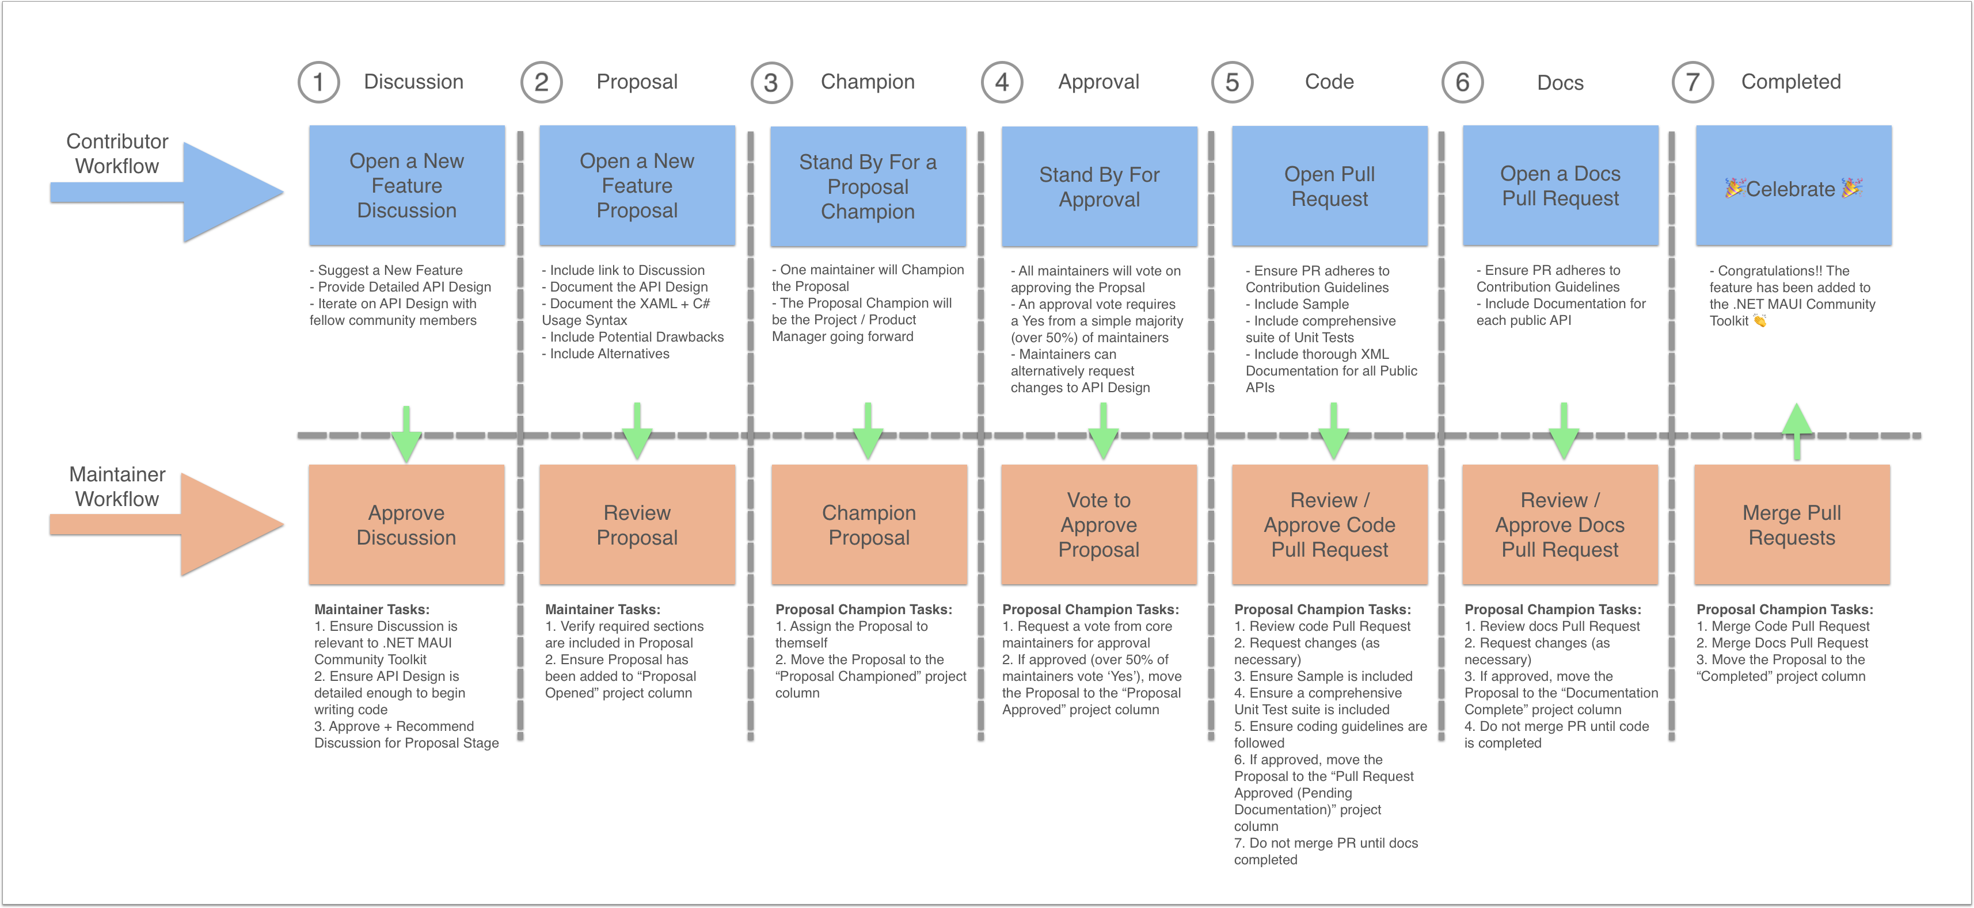
Contribute!
Submitting a new feature

Slide 28

Thanks for joining!
github.com/Samsung/Tizen.NET

